Slide 1
Linear independence

Slide 2
Linear dependence
^{e} set of n-vectors {a₁, . . . , a_{k} } (with k ≥ 1) is linearly dependent if
β₁a₁ + · · · + β_{k}a_{k} = 0
holds for some β₁, . . . , β_{k} , that are not all zero
^{e} equivalent to: at least one a_{i} is a linear combination of the others
^{e} we say ‘a₁, . . . , a_{k} are linearly dependent’
^{e} {a₁ } is linearly dependent only if a₁ = 0
^{e} {a₁, a₂ } is linearly dependent only if one a_{i} is a multiple of the other
^{e} for more than two vectors, there is no simple to state condition

Slide 3
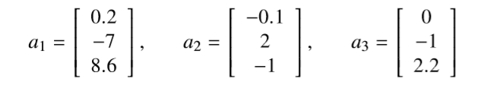
Example
^{e} the vectors
are linearly dependent, since a₁ + 2a₂ − 3a₃ = 0
^{e} can express any of them as linear combination of the other two, e.g.,
a₂ = (−1/2)a₁ + (3/2)a₃

Slide 4
Linear independence
^{e} set of n-vectors {a₁, . . . , a_{k} } (with k ≥ 1) is linearly independent if it is not linearly dependent, i.e.,
β₁a₁ + · · · + β_{k}a_{k} = 0
holds only when β₁ = · · · = β_{k} = 0
^{e} we say ‘a₁, . . . , a_{k} are linearly independent’
^{e} equivalent to: no a_{i} is a linear combination of the others
^{e} example: the unit n-vectors e₁, . . . , e_{n} are linearly independent

Slide 5
Linear combinations of linearly independent vectors
^{e} suppose x is linear combination of linearly independent vectors a₁, . . . , a_{k} :
x = β₁a₁ + · · · + β_{k}a_{k}
^{e} the coefficients β₁, . . . , β_{k} are unique, i.e., if
x = γ₁a₁ + · · · + γ_{k}a_{k}
then β_{i} = γ_{i} for i = 1, . . . , k
^{e} this means that (in principle) we can deduce the coefficients from x
^{e} to see why, note that
( β₁ − γ₁ )a₁ + · · · + ( β_{k} − γ_{k} )a_{k} = 0
and so (by linear independence) β₁ − γ₁ = · · · = β_{k} − γ_{k} = 0

Slide 6
Independence-dimension inequality
^{e} a linearly independent set of n-vectors can have at most n elements
^{e} put another way: any set of n + 1 or more n-vectors is linearly dependent

Slide 7
Basis
^{e} a set of n linearly independent n-vectors a₁, . . . , a_{n} is called a basis
^{e} any n-vector b can be expressed as a linear combination of them:
b = β₁a₁ + · · · + β_{n}a_{n}
for some β₁, . . . , β_{n}
^{e} and these coefficients are unique
^{e} formula above is called expansion of b in the a₁, . . . , a_{n} basis
^{e} example: e₁, . . . , e_{n} is a basis, expansion of b is
b = b₁e₁ + · · · + b_{n}e_{n}

Slide 8
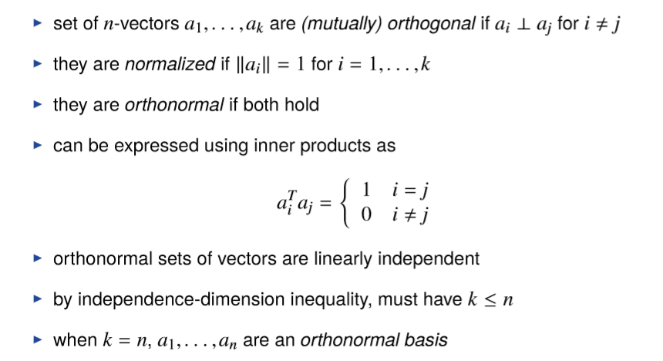
Orthonormal vectors

Slide 9
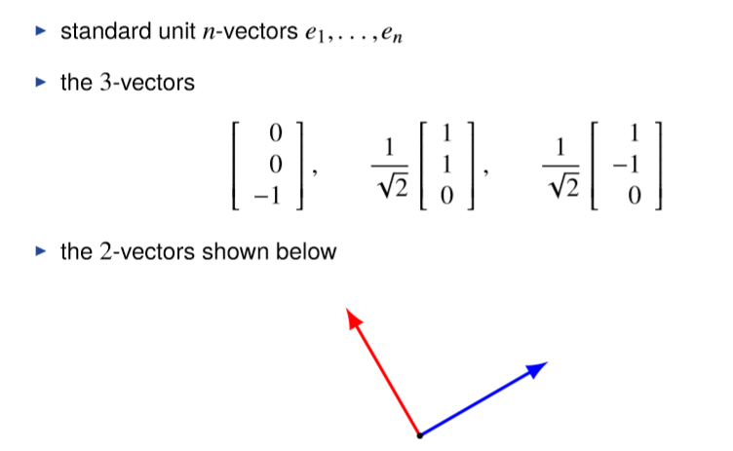
Examples of orthonormal bases

Slide 10

Orthonormal expansion
^{e} if a₁, . . . , a_{n} is an orthonormal basis, we have for any n-vector x
^{e} called orthonormal expansion of x (in the orthonormal basis)
^{e} to verify formula, take inner product of both sides with a_{i}

Slide 11
Gram–Schmidt (orthogonalization) algorithm
^{e} an algorithm to check if a₁, . . . , a_{k} are linearly independent
^{e} we’ll see later it has many other uses

Slide 12
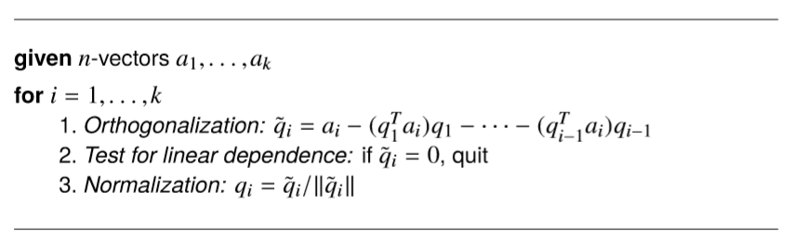
Gram–Schmidt algorithm
^{e} if G–S does not stop early (in step 2), a₁, . . . , a_{k} are linearly independent
^{e} if G–S stops early in iteration i = j, then a_{j} is a linear combination of
a₁, . . . , a_{j−1} (so a₁, . . . , a_{k} are linearly dependent)

Slide 13

Example
a₁
a₂
q˜₁
q₁
a₂
a₂
q₁
q₁
a₂
q˜₂
q₂

Slide 14
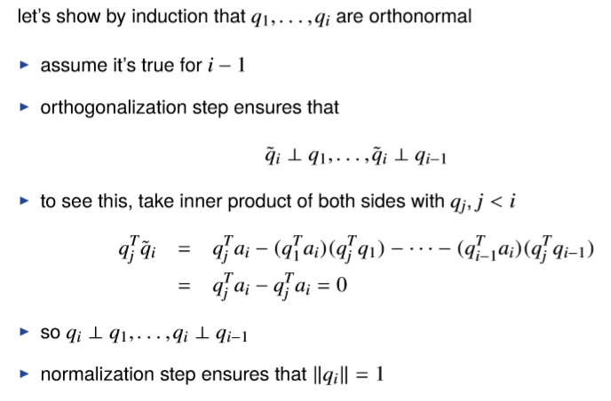
Analysis

Slide 15

Analysis
assuming G–S has not terminated before iteration i
^{e} a_{i} is a linear combination of q₁, . . . , q_{i}:
^{e} q_{i} is a linear combination of a₁, . . . , a_{i}: by induction on i,
and (by induction assumption) each q₁, . . . , q_{i−1} is a linear combination of
a₁, . . . , a_{i−1}

Slide 16

Early termination
suppose G–S terminates in step j
^{e} a_{j} is linear combination of q₁, . . . , q_{j−1}
^{e} and each of q₁, . . . , q_{j−1} is linear combination of a₁, . . . , a_{j−1}
^{e} so a_{j} is a linear combination of a₁, . . . , a_{j−1}

Slide 17

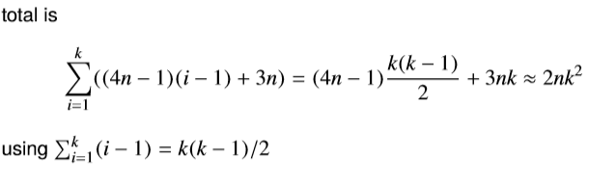
Complexity of Gram–Schmidt algorithm
^{e} step 1 of iteration i requires i − 1 inner products,
which costs (i − 1)(2n − 1) flops
^{e} 2n(i − 1) flops to compute q˜_{i}
^{e} 3n flops to compute

